Slide 1

Welcome!
Block 1: Coding Boot Camp
24th – 28th June 2019

Slide 2




Housekeeping
Fire Exits
Toilets
Refreshments
Smoking areas
Notes:
Fire Exits: Side door just outside the PC lab, also Clayden front door at other end of the building next to the toilets. Fire meeting point in the car park outside of the Knightley Building
Toilets: Disabled access toilet at the bottom of the stairs, 3 unisex toilets located under the stairs
Water: Available from the water fountain just outside of the PC lab
Tea & Coffee breaks: Tea & coffee will be available at scheduled times as per timetable in the Clayden Meeting Room. No hot drinks in the PC Lab. Please leave used mugs in the meeting room so they can be cleaned for re-use later
Lunch: Will be available in the Clayden Meeting room. Seating is very limited so please be mindful of others and utilise the outdoor space where possible.
You can use the picnic table outside of Knightley but please be aware people will be working in the offices so keep noise to a minimum particularly next to open windows
There is a kitchen in Clayden but this is a Staff Kitchen only. Please do not use.
Smoking: No smoking in the building, please refrain from smoking right outside open doors or windows.

Slide 3


Python programming
Why program?

Slide 4
Why program?
Course aims
Learn about -
Algorithms, functions, lists, loops, logic, reading and writing files, finding bugs, displaying results using graphs, etc.
Do -
Undertake a programming project applying skills you have learnt.
Notes:
Please do not reduce the font size as this is the recommended size for mobile phone users.
4

Slide 5
Why program?
The pre-history of programming
Computers are still very new
At the end 19th century machines were developed to automate arithmetic for book keeping and the processing of census data.
By the middle of the 20th century digital computers were solving business problems.
Notes:
Please do not reduce the font size as this is the recommended size for mobile phone users.
5

Slide 6
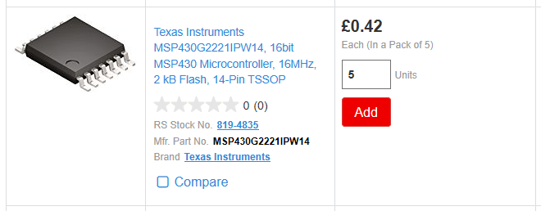
Why program?
Computers everywhere
Towards the end of the 20th century almost everything became digital – TV, music, communication, archiving.
Notes:
Please do not reduce the font size as this is the recommended size for mobile phone users.
6

Slide 7
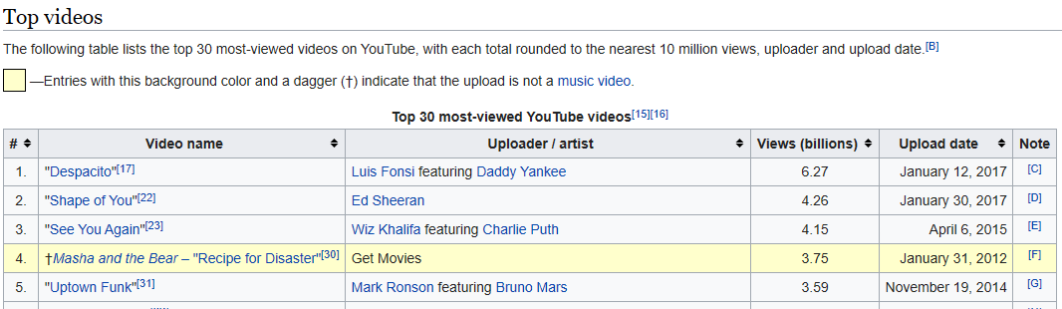
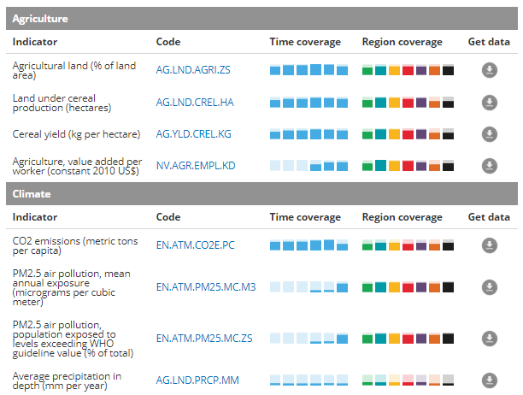
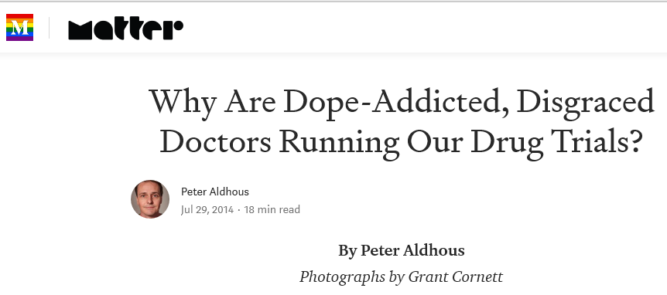
Why program?
Data on everything
Notes:
Please do not reduce the font size as this is the recommended size for mobile phone users.
7

Slide 8
Why program?
Uses for programming
Building software
Solving, or modelling, problems
Manipulating and moving data
Gluing programs together
Adding features to software
Notes:
Please do not reduce the font size as this is the recommended size for mobile phone users.
8

Slide 9
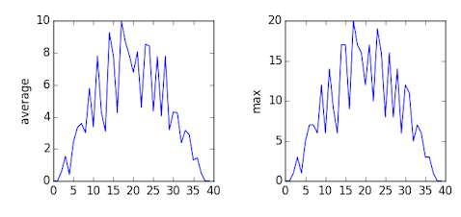
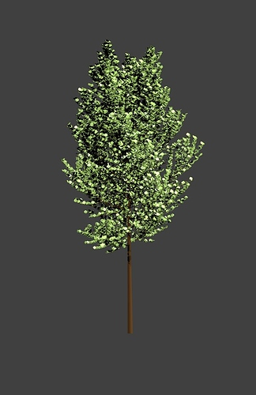
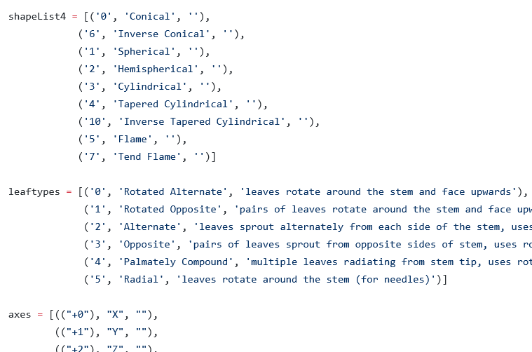
Why program?
Examples
Notes:
Blender, a 3D drawing program can be extended with Python scripts.
9

Slide 10
After this course
Working with research and experiment data
Automating tasks
Learn more Python – Data analysis, ML, Image processing, GIS…
Learn other programming languages
Teach it forward – help a friend learn Python
Notes:
Please do not reduce the font size as this is the recommended size for mobile phone users.
10

